Slide 1
Usage of Design Tools like Argo UML

Slide 2
ArgoUML
ArgoUML is an UML diagramming application written in Java and released under the open source Eclipse Public License. By virtue of being a Java application, it is available on any platform supported by Java SE.
Argo UML is a popular design tool used for creating Unified Modeling Language (UML) diagrams. UML is a visual modeling language used for software development, and it is used to describe the structure and behavior of software systems.
UML provides a graphical user interface for creating UML diagrams and models.

Slide 3
Here are some of the common use cases and scenarios where Argo UML can be useful:
Creating class diagrams: Argo UML can be used to create class diagrams, which are used to describe the structure of software systems. Class diagrams show the classes, interfaces, attributes, and methods of a system, and the relationships between them.

Slide 4
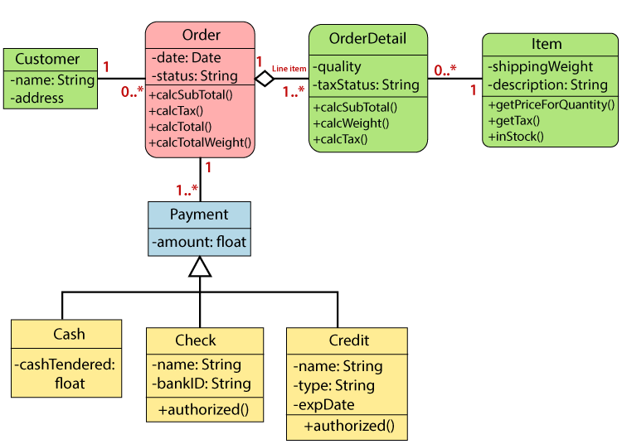
UML CLASS DIAGRAM

Slide 5
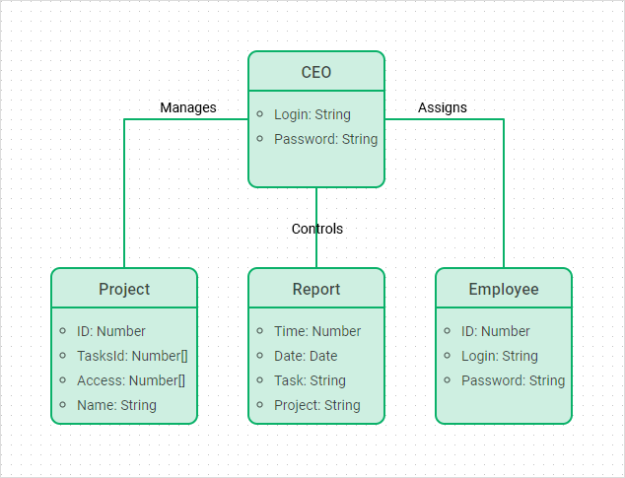

Slide 6
SEQUENCE DIAGRAM
Argo UML can be used to create sequence diagrams, which are used to describe the interactions between objects in a software system. Sequence diagrams show the messages exchanged between objects and the order in which they are exchanged.

Slide 7
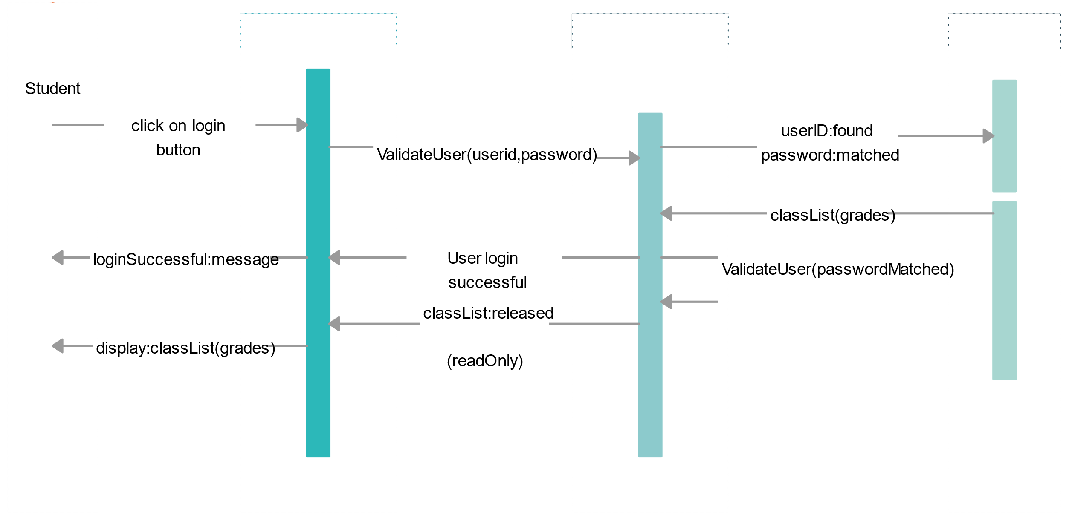
Sequence Diagram

Slide 8
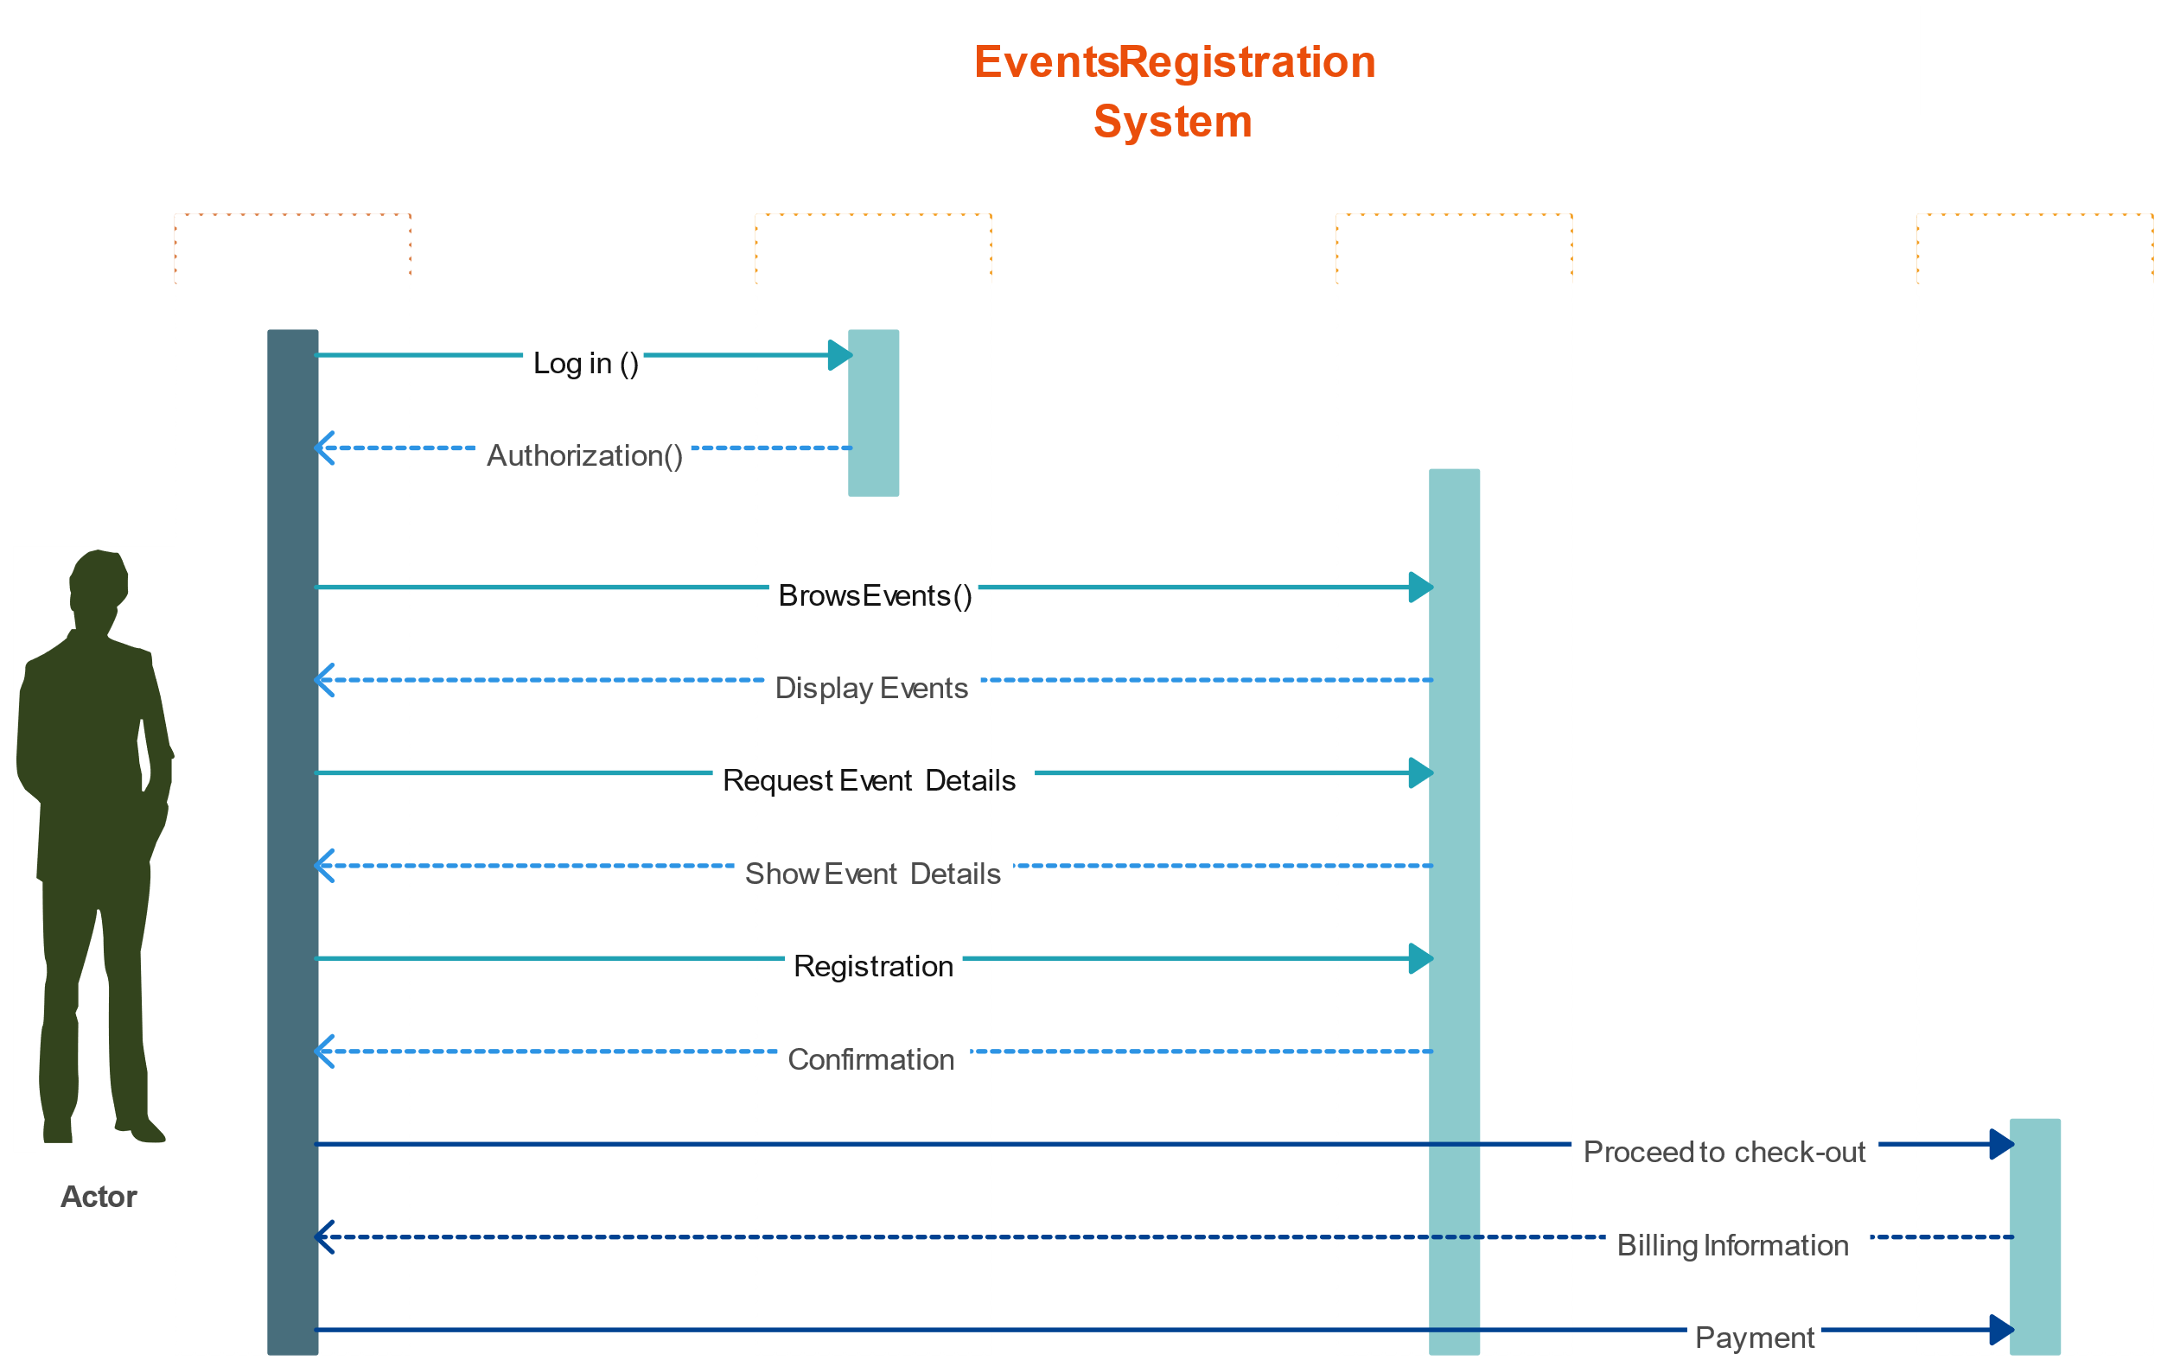

Slide 9
USE CASE DIAGRAM
Argo UML can be used to create use case diagrams, which are used to describe the behavior of software systems from the perspective of its users. Use case diagrams show the actors, use cases, and relationships between them.

Slide 10
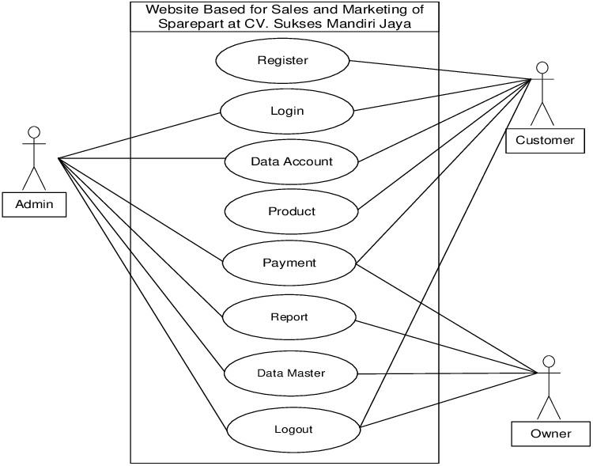

Slide 11
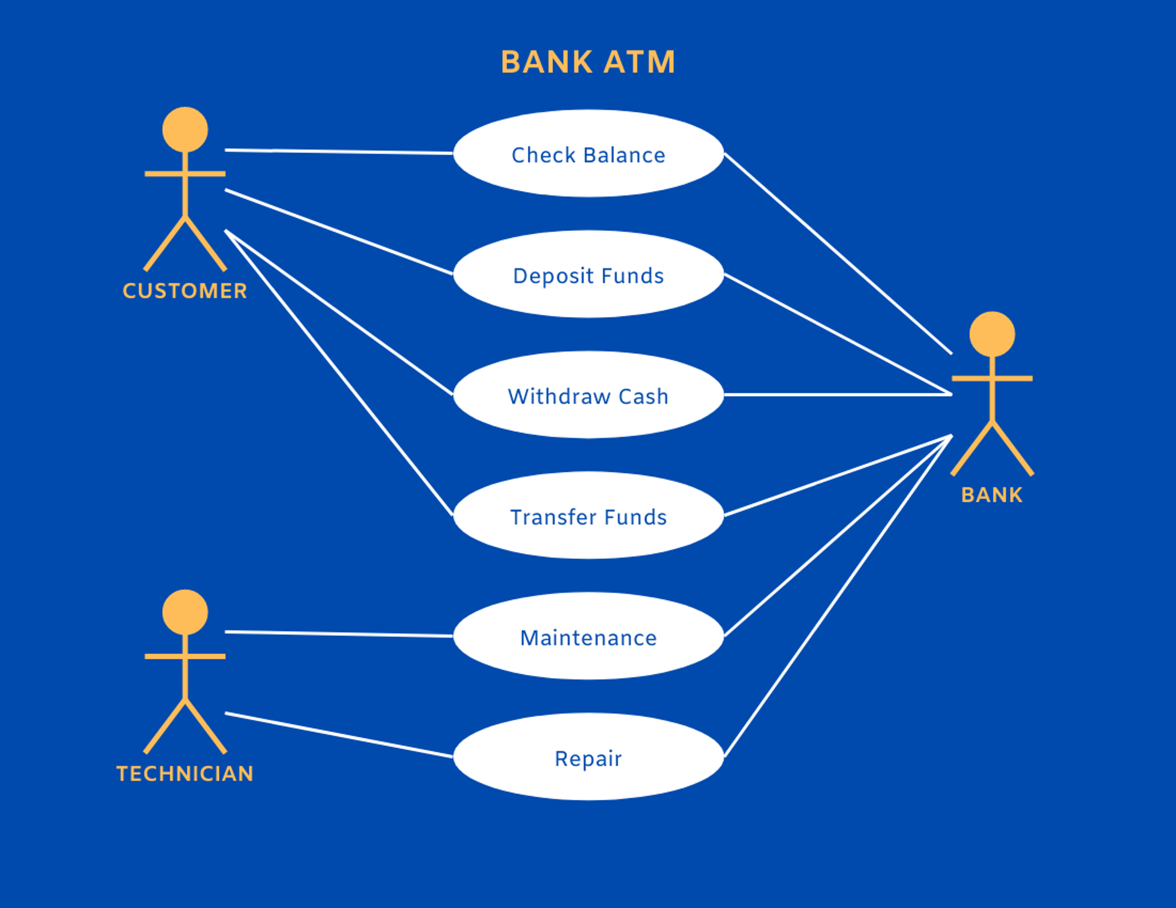

Slide 12
STATE MACHINE DIAGRAM
Argo UML can be used to create state machine diagrams, which are used to describe the behavior of objects in a software system. State machine diagrams show the states, events, and transitions of objects and the conditions under which transitions occur

Slide 13
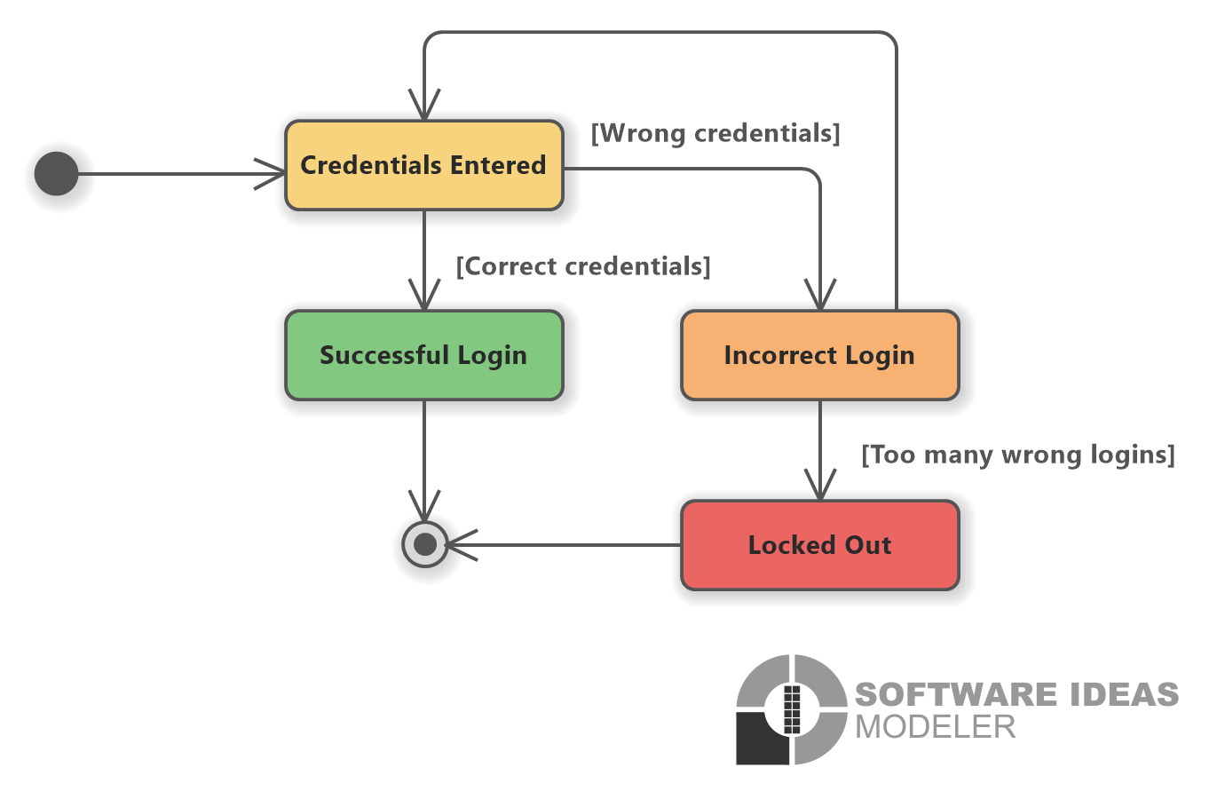

Slide 14
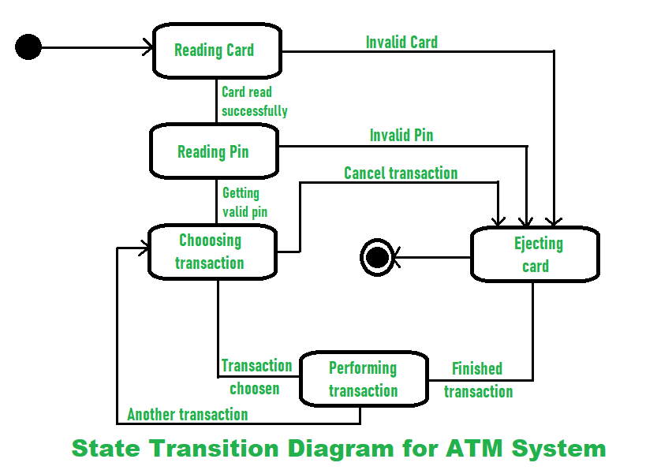

Slide 15
ACTIVITY DIAGRAM
Argo UML can be used to create activity diagrams, which are used to describe the flow of activities in a software system. Activity diagrams show the actions, control flows, and object flows of a system.

Slide 16
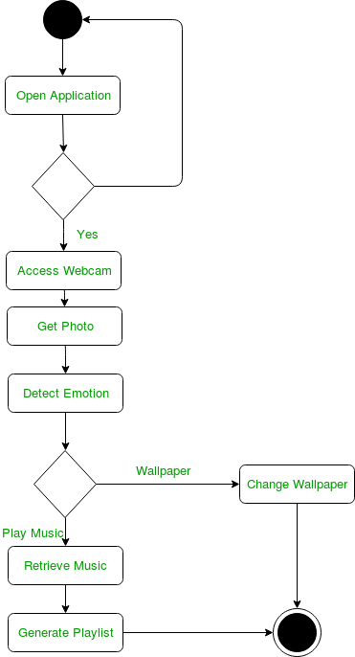

Slide 17
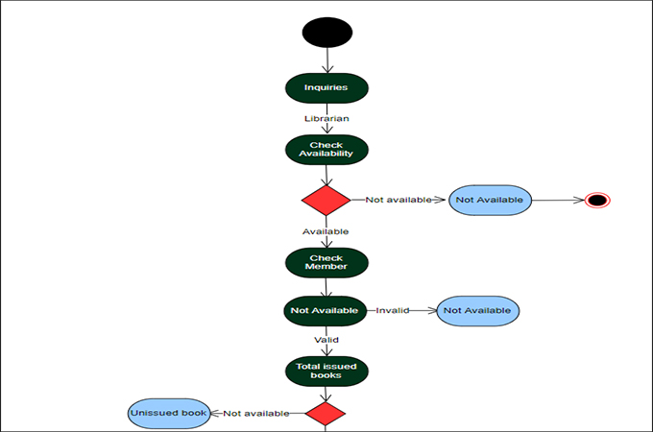

Slide 18
1. What is Argo UML used for?
a) Creating UML diagrams
b) Generating code
c) Testing software
d) None of the above

Slide 19
2. What is a UML diagram?
a) A diagram used for testing software
b) A diagram used for generating code
c) A visual representation of object-oriented software systems
d) None of the above

Slide 20
3. What types of UML diagrams can be created using Argo UML?
a) Use case diagrams
b) Class diagrams
c) Sequence diagrams
d) All of the above

Slide 21
4. What is the purpose of annotating UML diagrams?
a) To add color to the diagrams
b) To clarify ideas and capture important information
c) To reduce the size of the diagrams
d) None of the above

Slide 22
5. Can Argo UML automatically generate documentation based on UML diagrams?
a) Yes
b) No

Slide 23
How can documentation generated by Argo UML be used?
a) To prepare detailed notes about a software system
b) To create software prototypes
c) To debug software
d) None of the above

Slide 24
Can Argo UML be used to collaborate with others on UML diagrams?
a) Yes
b) No

Slide 25
What is the main advantage of using UML diagrams for software design?
a) They provide a graphical representation of the software system
b) They automate the software development process
c) They allow for easier debugging of software
d) None of the above

Slide 26
What is the purpose of a use case diagram?
a) To describe the behavior of a software system
b) To describe the structure of a software system
c) To describe the relationships between objects in a software system
d) None of the above

Slide 27
What is the purpose of a class diagram?
a) To describe the behavior of a software system
b) To describe the structure of a software system
c) To describe the relationships between objects in a software system
d) None of the above

Slide 28
What is the purpose of a sequence diagram?
a) To describe the behavior of a software system
b) To describe the structure of a software system
c) To describe the relationships between objects in a software system
d) None of the above

Slide 29
What is the purpose of an activity diagram?
a) To describe the behavior of a software system
b) To describe the structure of a software system
c) To describe the relationships between objects in a software system
d) None of the above

Slide 30
Create a class diagram using Argo UML for a simple banking system. The system should include classes for customers, accounts, and transactions. Each customer can have multiple accounts, and each account can have multiple transactions.

Slide 31
Answers:
The resulting class diagram should show three classes (Customer, Account, and Transaction) and their attributes and methods.
The "Customer" class should have attributes such as "Name", "Address", and "Phone Number", and methods such as "Create Account", "Close Account", and "View Transactions".
The "Account" class should have attributes such as "Account Number", "Balance", and "Type", and methods such as "Deposit", "Withdraw", and "View Transactions".
The "Transaction" class should have attributes such as "Transaction ID", "Date", and "Amount", and methods such as "View Details" and "Print Receipt". arrows to show the direction of the associations.

Slide 32
The "Customer" class should have an association with the "Account" class with a multiplicity of "1 to many", indicating that a customer can have multiple accounts. The "Account" class should have an association with the "Transaction" class with a multiplicity of "1 to many", indicating that an account can have multiple transactions. The class diagram should have clear labels and

